Slide 1
Micro Credit Defaulter Dataset Predicting the defaulter
Rajesh.J
rajesh112j@gmail.com

Slide 2
Agenda
Agenda
Data Set Description
Data Set EDA
DATA Set Machine Learning
Machine Learning Analysis
Prediction

Slide 3

Exploratory data Analysis (EDA)

Slide 4
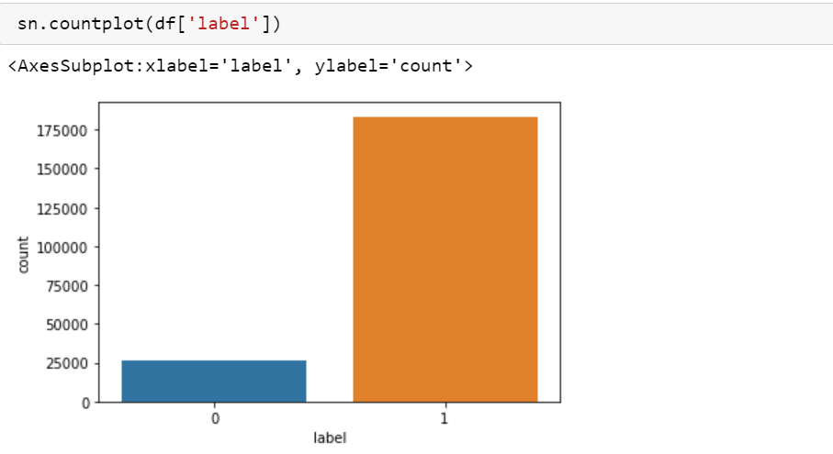
LABEL : Value 0 (defauter)and 1

Slide 5
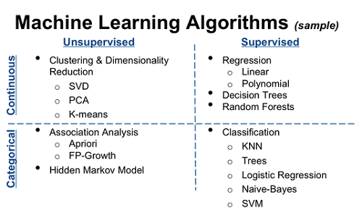
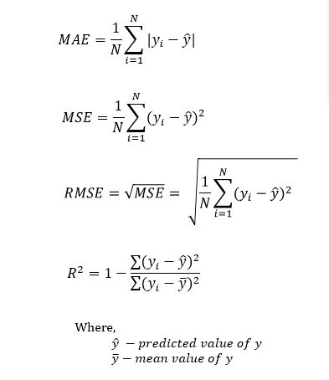
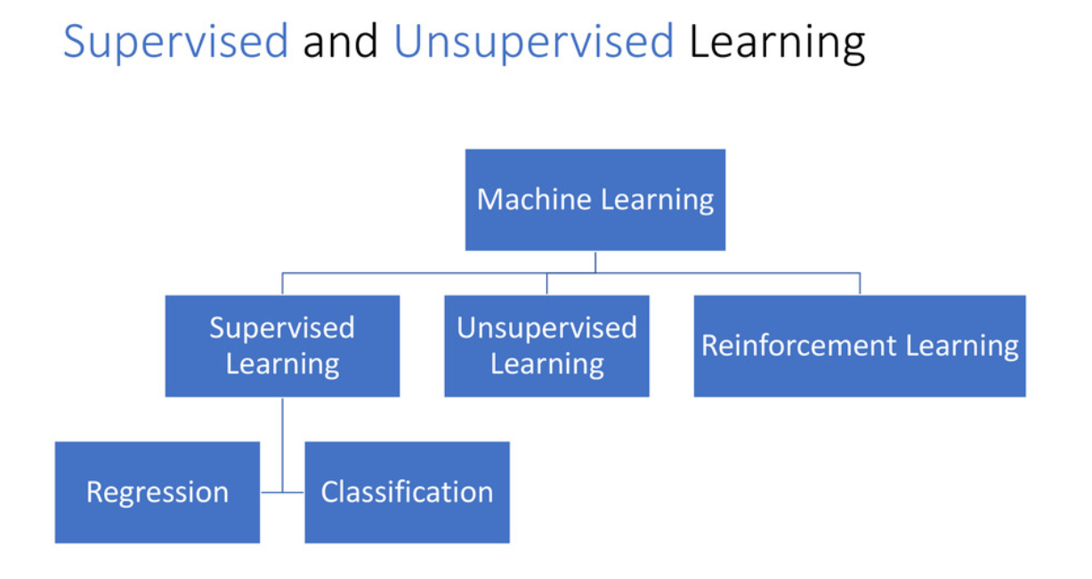
Models used to Evaluate
Linear Regression
Decision Tree
Manually Tuned
Tuned by Grid Search
Random Forest
Manually Tuned
Tuned by Random Search
Model Evaluation Metrics

Slide 6
Check if…
Multicollinearity is not present
The error term normally distributed

Slide 7
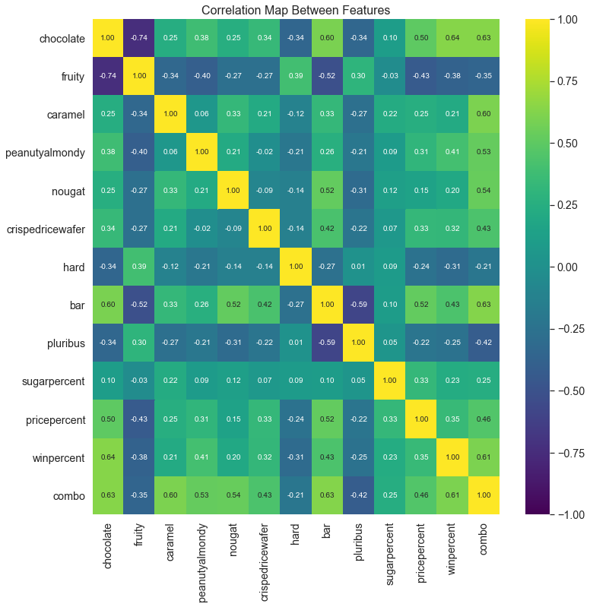
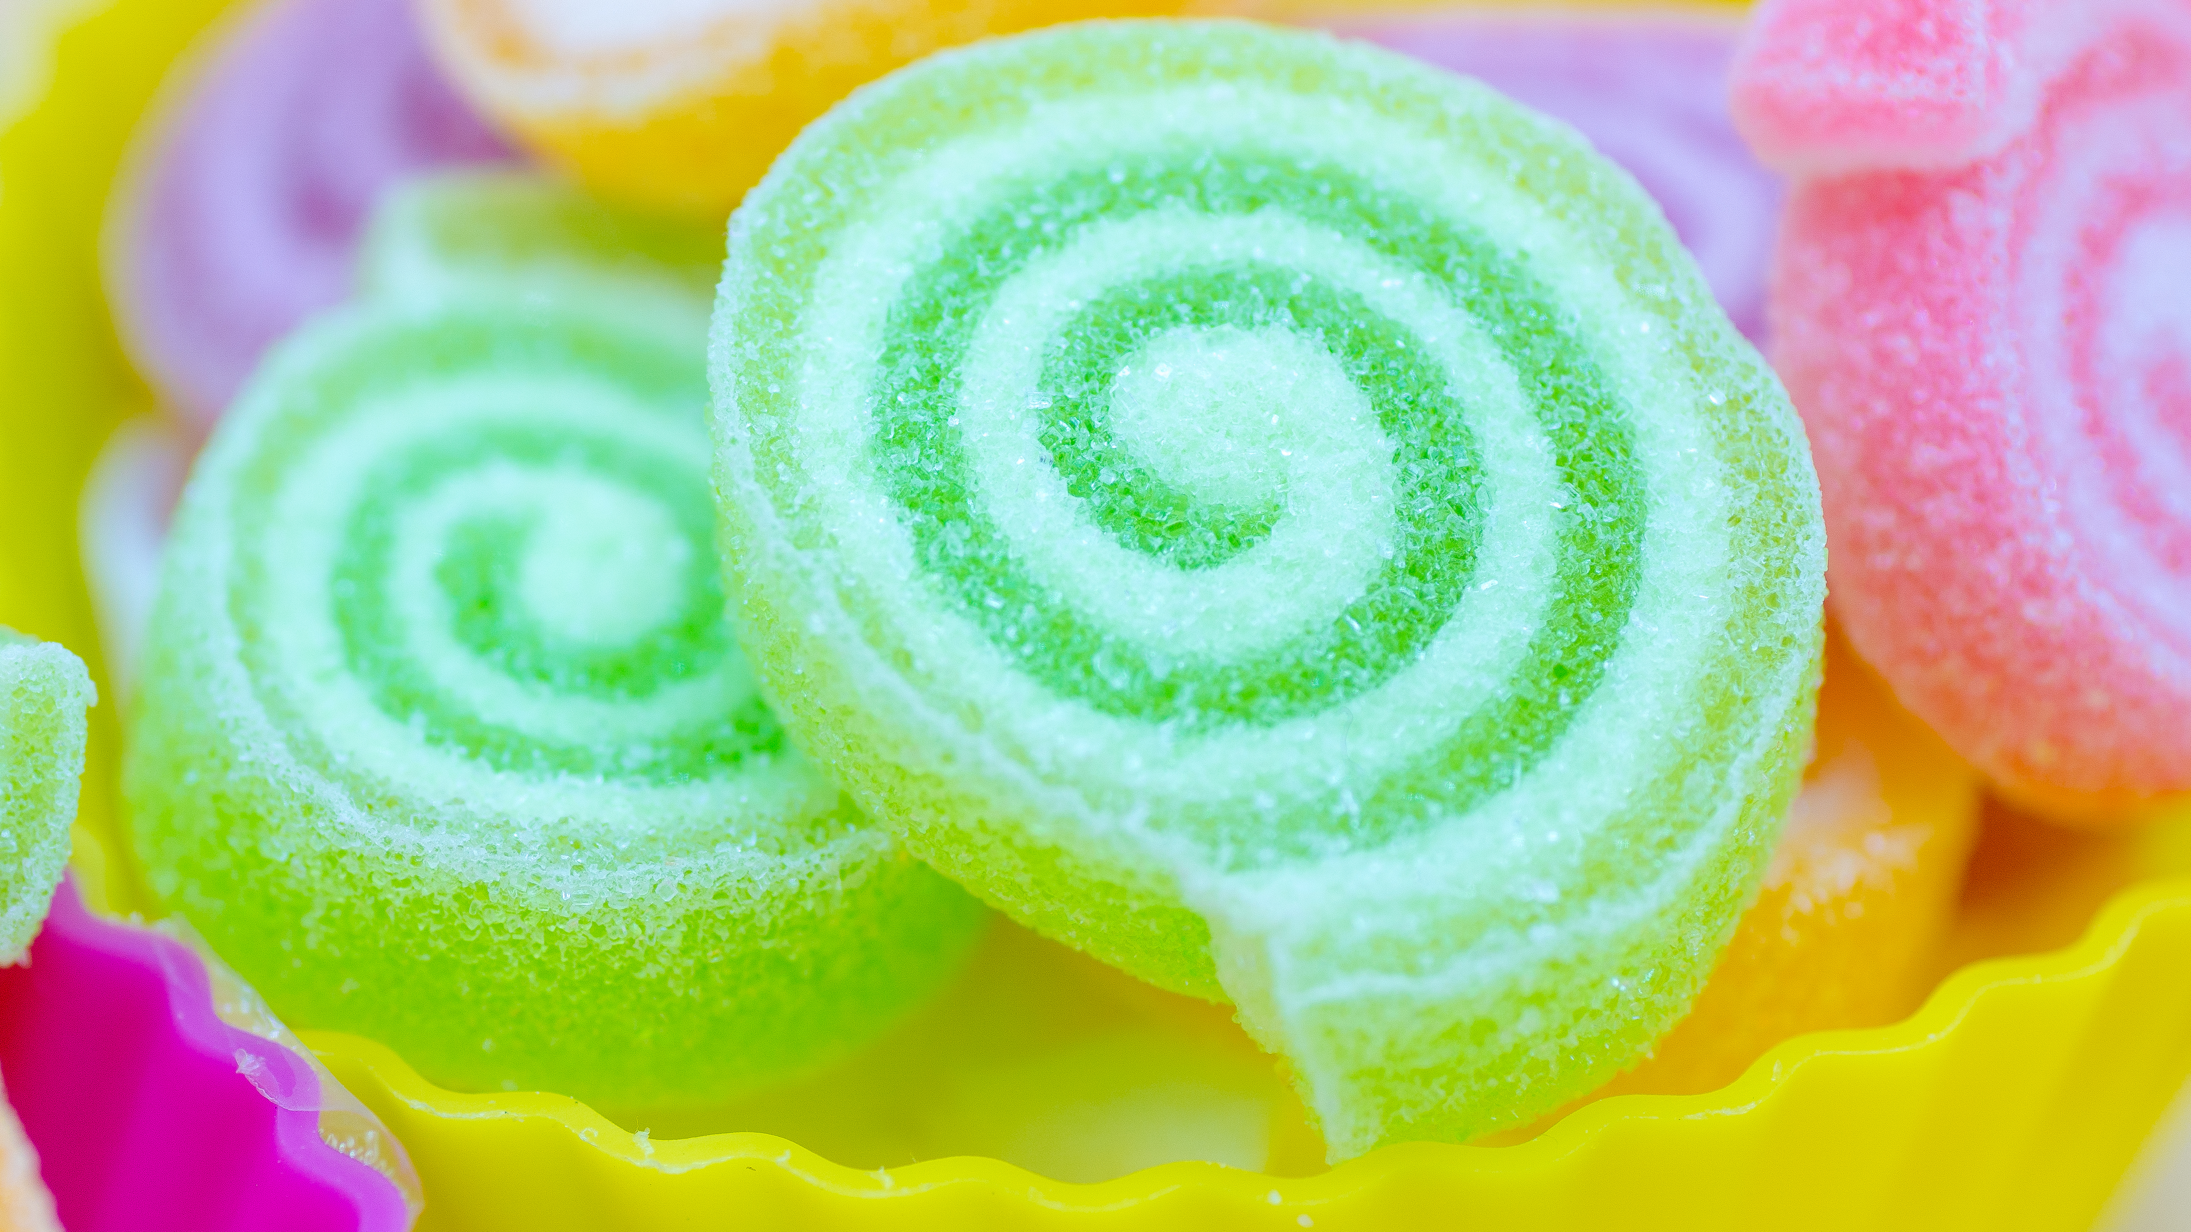
Chocolate is highly co-related to Winpercent.
There is no significant co-relation between the features.
Hence we can rule out multicollinearity

Slide 8
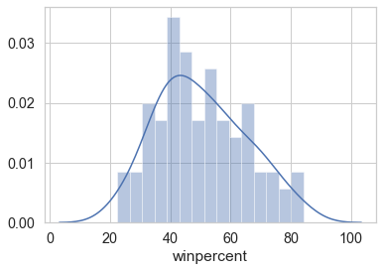
Target Variable - Normally Distributed ?
Observation: Winpercent (target variable) is normally distributed, so we can proceed with the model building

Slide 9
Train & Test:
Features & Target
features = ['chocolate', 'fruity', 'caramel', 'peanutyalmondy','nougat', 'crispedricewafer', 'hard', 'bar', 'pluribus', 'sugarpercent', 'pricepercent']
target = ['winpercent']
Test –Set 20%: Shape of Train & Test Set
Train cases as below
X_train shape : (68, 11)
y_train shape: (68, 1)
***************************
Test cases as below
X_test shape: (17, 11)
y_test shape: (17, 1)

Slide 10
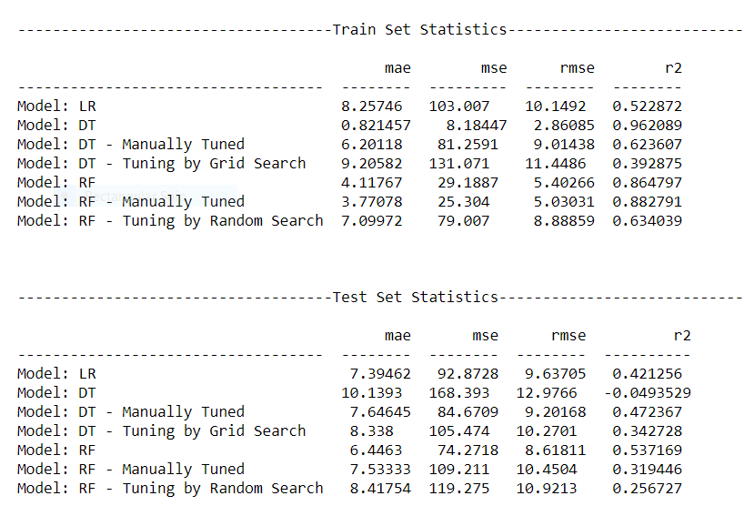
All Machine Learning Algorithm Statistics for Train & Test

Slide 11
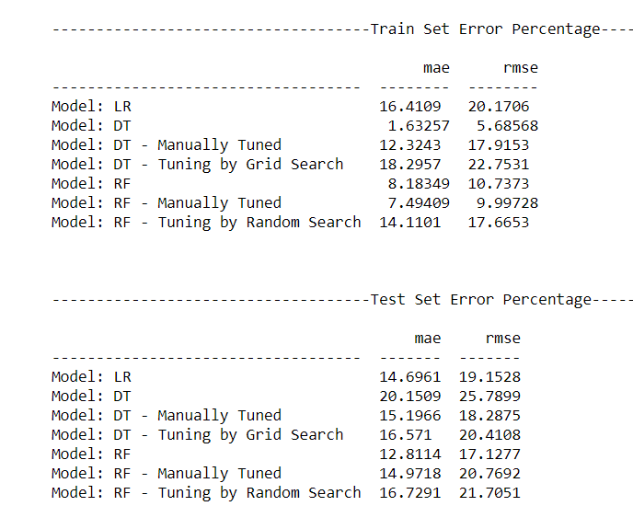
Model Evaluation- Error Percentage

Slide 12
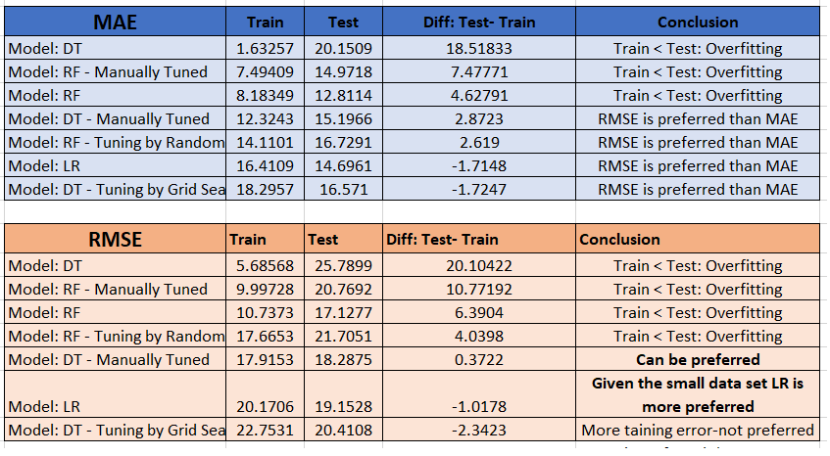
Model Evaluation- Error Percentage- Analysis & Conclusion

Slide 13
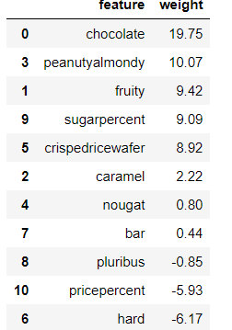
Linear Regression Equation & Conclusion
'winpercent = + 19.748 * chocolate + 9.422 * fruity + 2.224 * caramel
+ 10.071 * peanutyalmondy + 0.804 * nougat + 8.919 * crispedricewafer
- 6.165 * hard + 0.442 * bar - 0.854 * pluribus
+ 9.087 * sugarpercent - 5.928 * pricepercent + 34.534'
Considering the complete data set, the average winning rate is 50.3% in 85 products.
As per the evaluation with (80:20) training and testing data
Chocolate is the most important attribute of a candy followed by Peanutyalmondy and crispedricewafer
The candy need not be fruit flavored
The candy must NOT be hard
The candy might or might NOT be bar
The candy might or might NOT be one of the many candies in the box or bag
The candy must have sugar content
The candy must be priced in the low range

Slide 14




